Slide 1
Antiarrhythmic Drugs
2022 대한부정맥학회 추계학술대회
서울특별시 보라매병원
임우현, MD

Slide 2
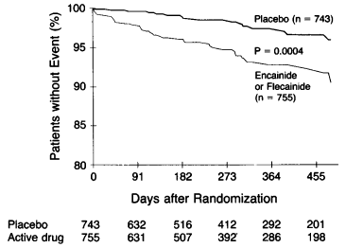
CAST (Cardiac Arrythmia Supression Trial)
Prior MI, frequent PVCs
Death or cardiac arrest d/t arrhythmia
AADs can be potentially dangerous, especially in the presence of structural heart disease.
N Engl J Med 1991; 324:781-8

Slide 3
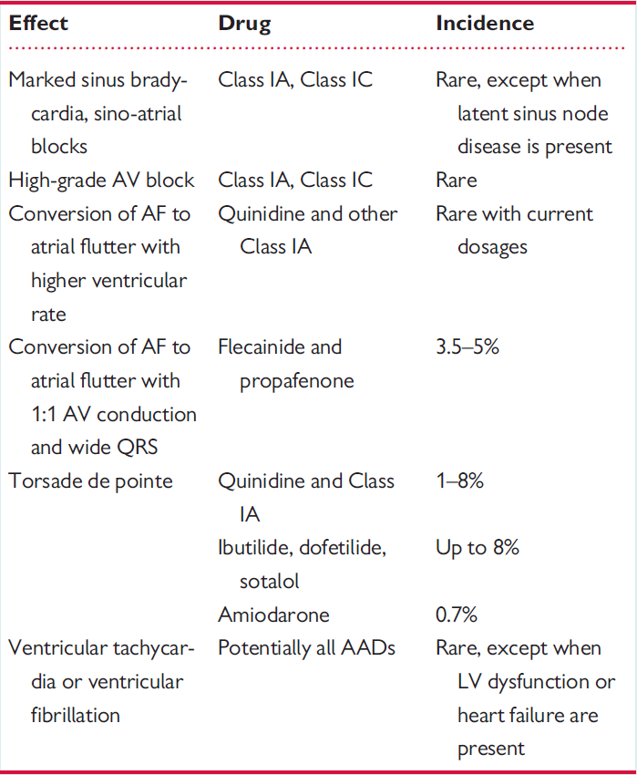
Proarrhythmic effects with AADs
Europace (2018) 20, 731–732

Slide 4
Treatment of arrhythmia with AAD
Arrhythmia as a marker of disease vs. Arrhythmia as a disease
VF in patient with HFrEF vs. PSVT
Antiarrhythmic drugs
Narrow therapeutic window
Drug-induced proarrhythmia or extracardiac side-effects are frequent
High degree of inter-subject variability
Some AADs have multiple electrophysiological and pharmacologic effects
Almost all AADs can reduce cardiac performance
Safety rather than efficacy considerations should primarily guide the choice of AAD

Slide 5
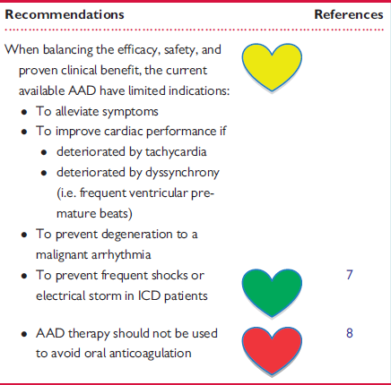
AAD: clinical use and clinical decision making
Europace (2018) 20, 731–732

Slide 6
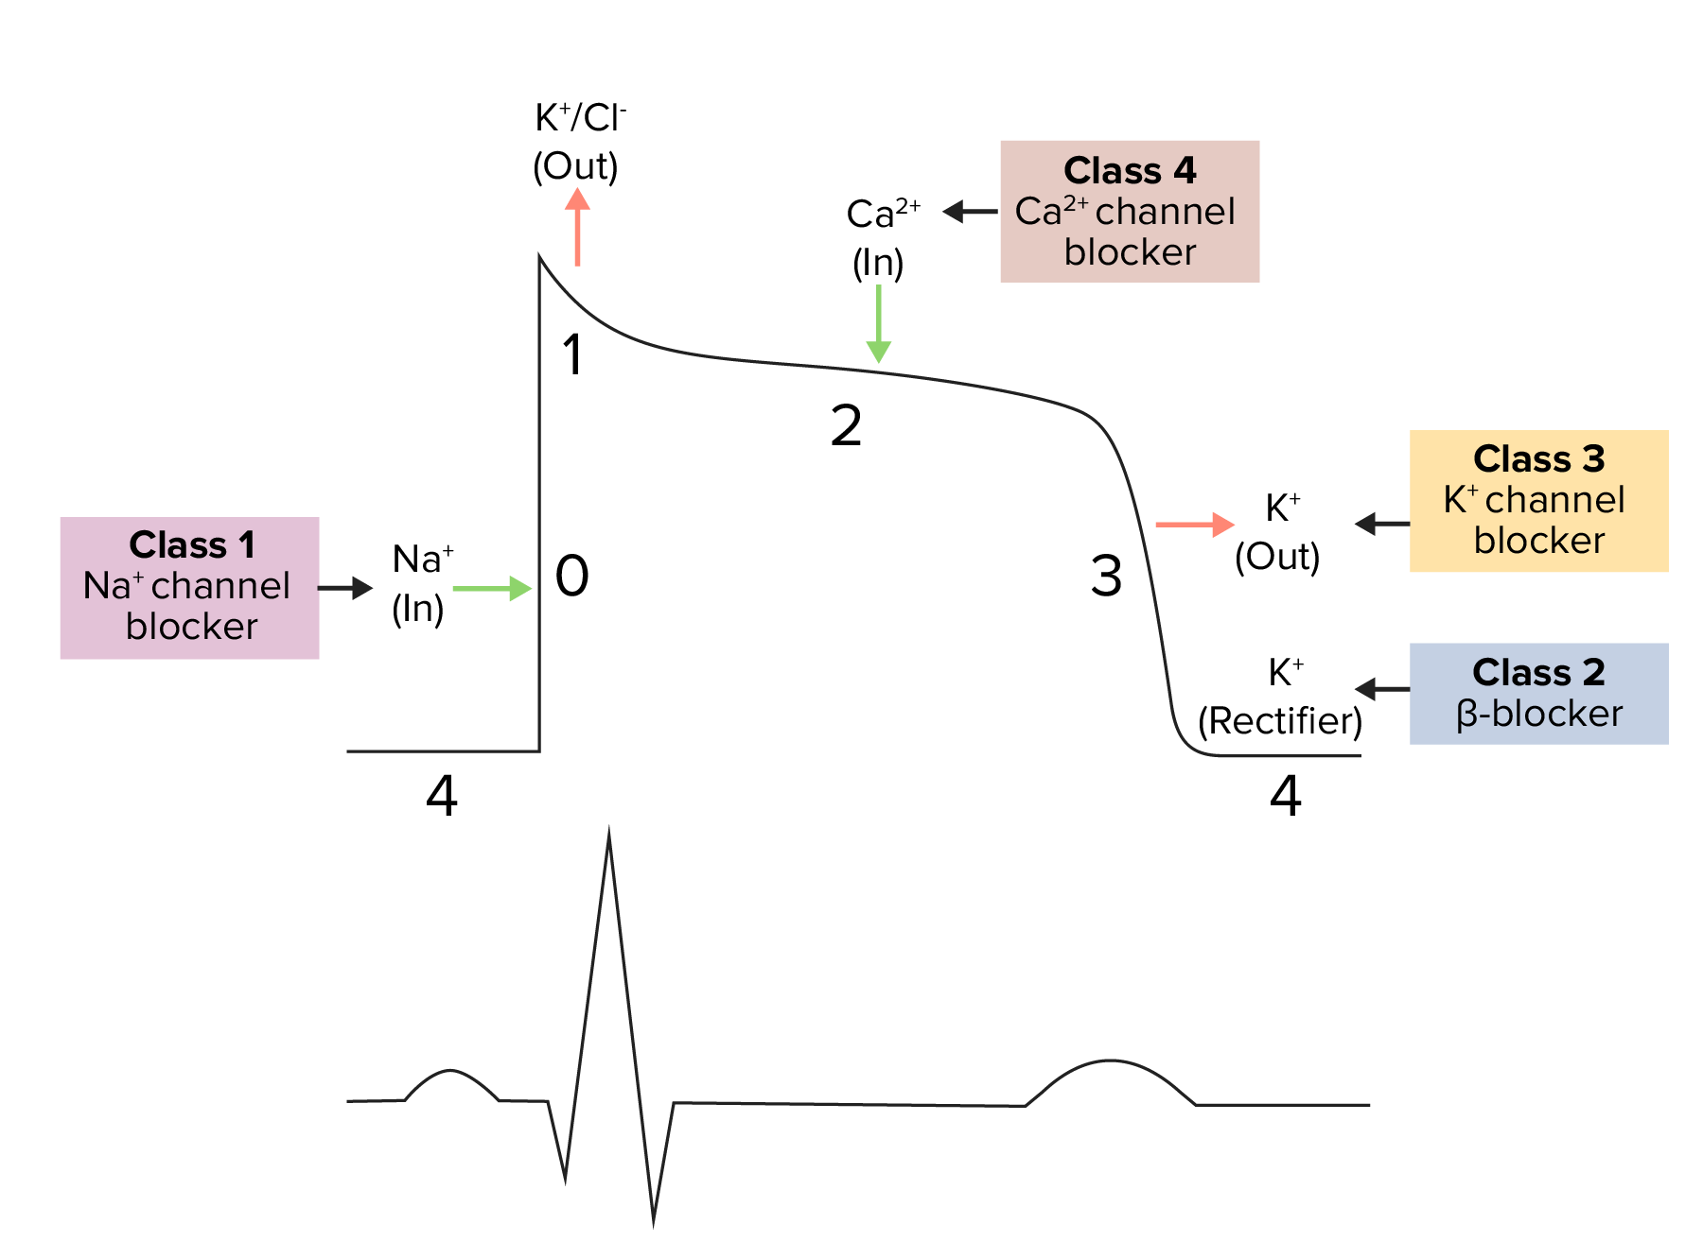
Singh-Vaughan Williams Classification of AADs
Class I: I_{Na} blocker
Class I_{A} (QT↑): disopyramide, procainamide, quinidine
Class I_{B} (QT↓): lidocaine, mexiletine
Class I_{C} (QT~, QRS↑): flecainide, propafenone
Class II: beta-blocker
Class III: I_{K} blocker
Sotalol, amiodarone, dronedarone
Dofetilide, ibutilide
QT↑
Class IV: I_{Ca-L} blocker
Verapamil, diltiazem
Class V
Adenosine, atropine, digoxin
Ivabradine, vernakalant

Slide 7
AAD in patients with CKD
No dosage adjustment
Lidocaine, mexiletine
Amiodarone, dronedarone, vernakalant
Use with caution
Propafenone, diltiazem
Dose reduction
Procainamide, flecainide, verapamil
Contraindication in severe renal failure
Sotalol, quinidine
Europace (2018) 20, 731–732

Slide 8
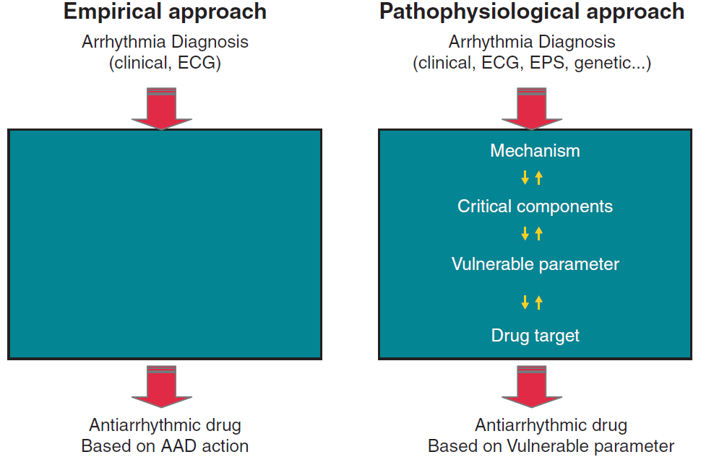
The concept of the ‘vulnerable parameter’
Notes:
While classic approach is based on the AAD properties (Singh–Vaughan Williams classification)
with final aim to alter excitability, conduction or automaticity irrespective of the arrhythmia type, the modern AAD therapy is based on discovering the critical components of the arrhythmia and identifying the vulnerable parameter

Slide 9
Early rhythm control can reduce adverse cardiovascular outcomes (EAST-AFNET 4)
2789 patients with early AF
Early rhythm control (n=1395) vs. usual care (n=1394)
Early rhythm control: AAD or AF ablation, cardioversion of persistent AF
N Engl J Med 2020;383:1305-16.

Slide 10
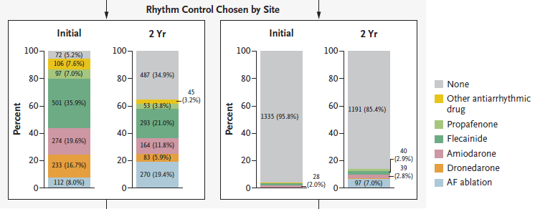
Rhythm Control Strategy in EAST-AFNET 4
In the early rhythm control group, 45.7% of patients were treated with antiarrhythmic drugs at 2 years
Early Rhythm Control
Usual Care
N Engl J Med 2020;383:1305-16.

Slide 11
Long-term rhythm control therapy
2020 ESC Guidelines for the diagnosis and management of AF

Slide 12
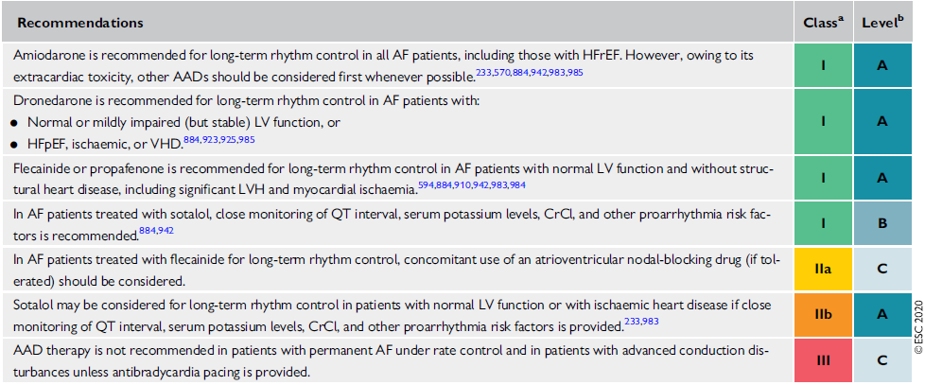
Recommendations for long-term AADs

Slide 13
Class IC vs. III, From the TREAT-AF Study
Retrospective cohort study of patients with AF/AFL from 2004 to 2014 and class IC or class III AAD prescription
Class IC vs. III as an initial rhythm control strategy in new AF
J Am Coll Cardiol EP 2019;5:231–41

Slide 14
Flecainide
Flecainide 100 – 200mg BID or flecainide SR 200mg QD
Usually 50-100mg BID in Korea
CrCl <35 mL/min, significant liver disease → should not be used
Ischemic heart disease or reduced LVEF → contraindication
QRS widening >25% above baseline, LBBB or any other conduction block >120ms → should be discontinued
SA/AV conduction disturbances → caution
AFL cycle length↑, thus promoting 1:1AV conduction → concomitant administration of AV nodal blocking drug (BB, NDCC)
ECG at baseline, after 1 – 2 weeks

Slide 15
Propafenone
Nonspecific minimal beta-blocking effect
Propafenone 150-300mg TID or 225-425mg SR BID
Usually 150mg TID or 225-325mg SR BID in Korea
Significant renal or liver disease, ischemic heart disease, reduced LVEF, or asthma → should not be used
QRS widening >25% above baseline, LBBB or any other conduction block >120ms → should be discontinued
SA/AV conduction disturbances → caution
AFL cycle length↑, thus promoting 1:1AV conduction → concomitant administration of AV nodal blocking drug (BB, NDCC)
ECG at baseline, after 1 – 2 weeks

Slide 16
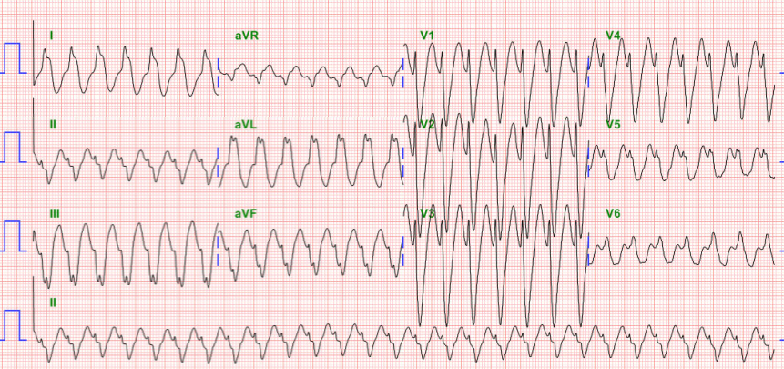
Atrial flutter 1:1 AV conduction Wide QRS d/t use-dependency
M/65, PAF on flecainide 100mg bid

Slide 17
Amiodarone
3 x 200mg daily over 4 weeks, then 200mg daily
The most effective AAD, reduce ventricular rate (for 10-12 bpm), safe in patients with HF
Concomitant use with VKAs or digitalis → their dose should be reduced
Increased risk of myopathy when used with statins
Requires regular surveillance for liver, lung, and thyroid toxicity
QT prolongation is common but rarely associated with torsades de pointes (<0.5%) → QT-interval and TUwave monitoring
Concomitant use with other QT-prolonging drugs with caution
Excessive QT prolongation (>500 ms) → should be discontinued
ECG at baseline, after 4 weeks
Contraindicated in manifest hyperthyroidism
Numerous and frequent extracardiac side-effects may warrant discontinuation of amiodarone, thus making it a second-line treatment when other choices are possible

Slide 18
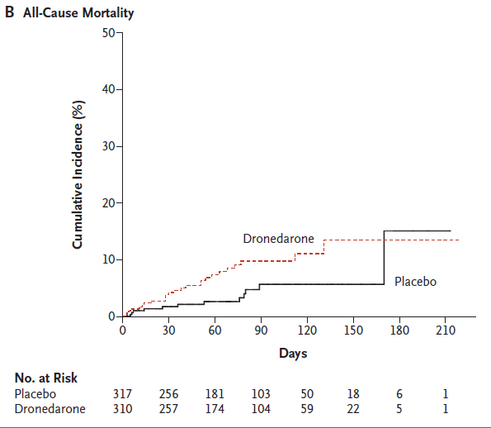
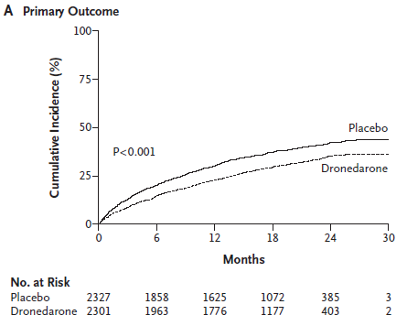
RCTs: Dronedarone vs. Placebo
ATHENA
ANDROMEDA
Paroxysmal or persistent AF/AFL and cardiovascular comorbidity
Patient hospitalized with HF and severe LV dysfunction
Cardiovascular hospitalization or death
HR 0.76 (95% CI 0.69-0.84)
HR 2.13 (95% CI 1.07-4.25)

Slide 19
Dronedarone
400mg BID, AV nodal-slowing properties
Less effective than amiodarone in rhythm control but has very few extracardiac side-effects
Reduces cardiovascular hospitalizations and death in patients with paroxysmal or persistent AF or AFL and cardiovascular comorbidity → preferable first choice
Mortality↑ in patients with recent decompensated HF or permanent AF
Should not be used in NYHA class III or IV or unstable HF, in combination with QT-prolonging drugs or with strong CYP3A4 inhibitors (e.g. verapamil, diltiazem) and in patients with CrCl <30 mL/min
Concomitant use with dabigatran is contraindicated
Combination with digoxin may significantly increase digoxin serum concentration
When used with digitalis or beta-blockers their doses should be reduced
Excessive QT prolongation (>500 ms or >60 ms increase) → should be discontinued
A modest increase in serum creatinine is common and reflects drug induced reduction in CrCl rather than a decline in renal function
ECG at baseline and after 4 weeks

Slide 20
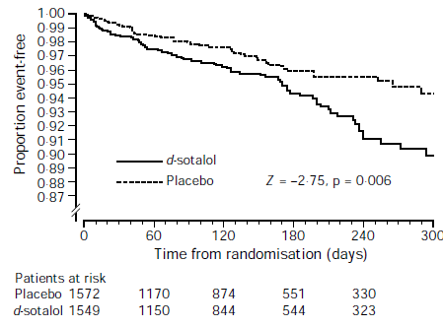
SWORD (Survival With Oral d-Sotalol) Trial
Patients with LVEF<40% and either recent MI or HF d/t remote MI
Sotalol 100~200mg BID vs. Placebo
Mortality
Lancet 1996; 348: 7–12

Slide 21
Sotalol
80 – 160 mg BID
Usually 40-80mg BID in Korea
Only class III effects if dosing >160 mg daily
Considering its safety and efficacy and potential drug alternatives, sotalol should be used with a caution
Should not be used in patients with HFrEF, significant LVH, prolonged QT, asthma, hypokalemia, or CrCl <30 mL/min
Dose-related torsades de pointes may occur in >2% of patients
Excessive QT prolongation (>500 ms or >60 ms increase) → should be discontinued
Controversial data on safety
ECG at baseline, after 1 day and after 1 - 2 week

Slide 22
항부정맥제 치료 – 요약
부정맥 치료의 목적 및 항부정맥제 사용 여부 결정
구조적 심장질환 및 심부전 유무 확인
LV dysfunction, LVH, significant valvular disease, CAD
Echocardiography, treadmill test
항부정맥제 선택 (심방세동의 경우)
안전 > 효과
구조적 심장질환 (-): flecainide, propafenone, dronedarone, sotalol
구조적 심장질환 (CAD, HFpEF, significant valvular disease): dronedarone, amiodarone, sotalol
HFrEF (EF<40%): amiodarone
모니터링: ECG (QT, QRS duration), electrolyte, organ toxicity

Slide 23
감사합니다.

